Slide 1
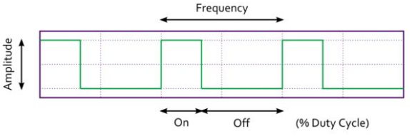
What is PWM?
Pulse Width Modulation (PWM) is a technique for creating a digital square wave signal.
A square wave has 3 main characteristics
Amplitude - The amount the signal changes between On and Off states
Frequency - The number of times the signal repeats in a given time frame
Duty Cycle - The proportion of On time to Off time usually expressed as a percentage

Slide 2
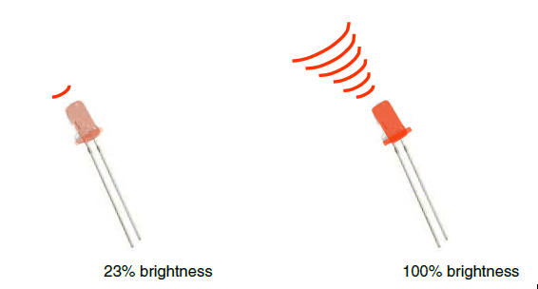
Analog Output
Can a digital devise produce analog output?
Image from Theory and Practice of Tangible User Interfaces at UC Berkley
Analog output can be simulated using pulse width modulation (PWM)

Slide 3
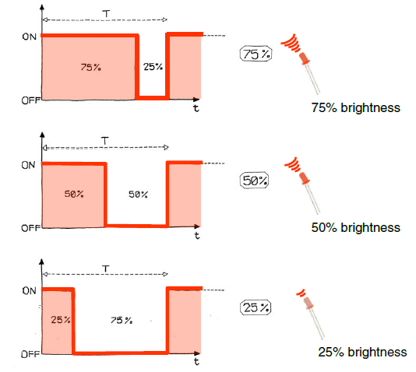
Pulse Width Modulation
Can’t use digital pins to directly supply say 2.5V, but can pulse the output on and off really fast to produce the same effect
The on-off pulsing happens so quickly, the connected output device “sees” the result as a reduction in the voltage
Image from Theory and Practice of Tangible User Interfaces at UC Berkley

Slide 4
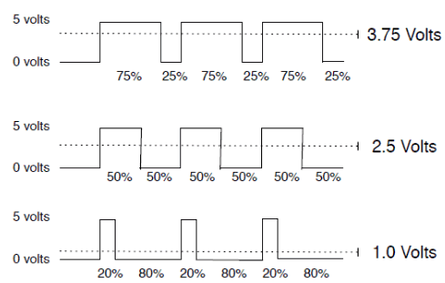
PWM Duty Cycle
output voltage = (on_time / cycle_time) * 5V
Image credit: Tod Kurt
Fixed cycle length; constant number of cycles/sec

Slide 5
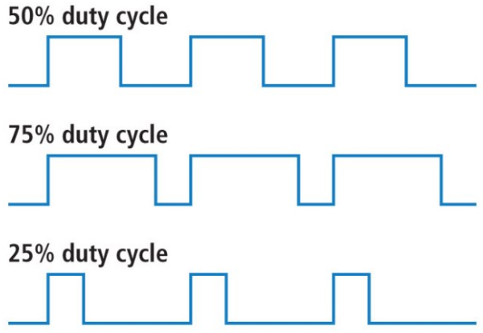
Duty cycles

Slide 6
Arduino function for NodeMCU PWM
analogWrite(pin,dutycycle): Enables software PWM on the specified pin. duty cycle is in the range from 0 to PWMRANGE, i.e. 1023 by default.
analogWrite(pin, 0): Disables PWM on the specified pin.
analogWriteFreq(new_frequency): PWM frequency is 1kHz by default. Call this function to change it with new frequency.PWM frequency is in the range of 1 – 1000Khz.

Slide 8
int ledPin = D2;
void setup()
{
}
void loop()
{
for (int fadeValue = 0 ; fadeValue <= 1023; fadeValue += 5) {
analogWrite(ledPin, fadeValue);
delay(30);
}
for (int fadeValue = 1023 ; fadeValue >= 0; fadeValue -= 5) {
analogWrite(ledPin, fadeValue);
delay(30);
}
}

Slide 9
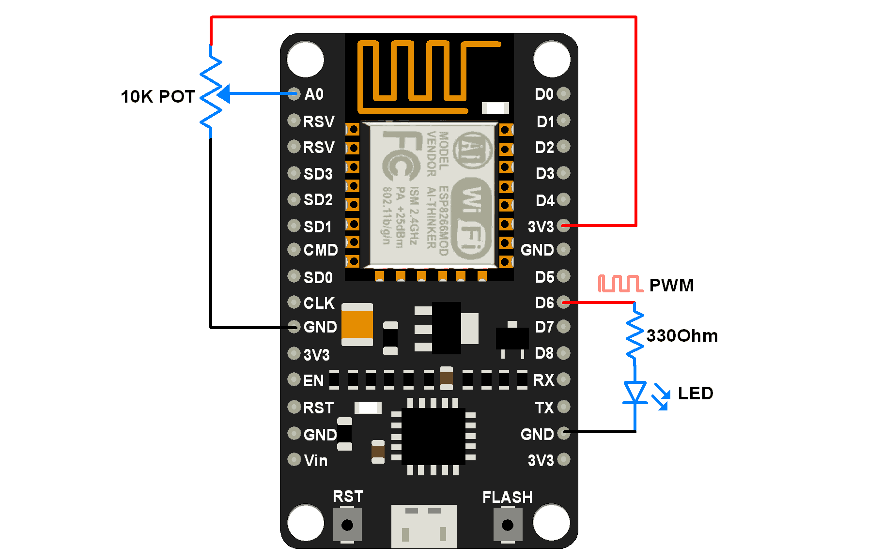

Slide 10
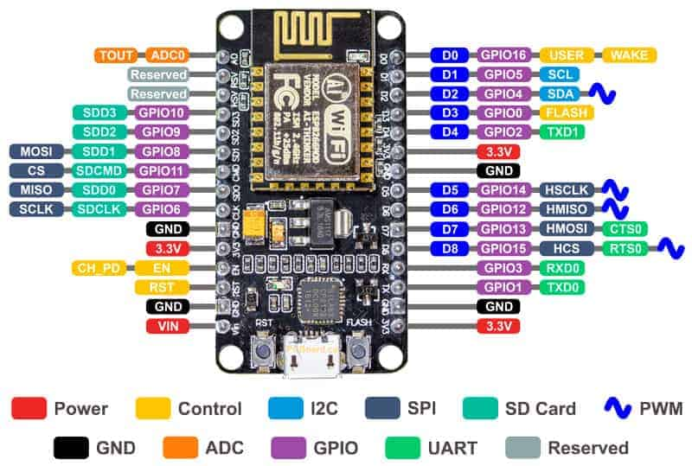

Slide 11
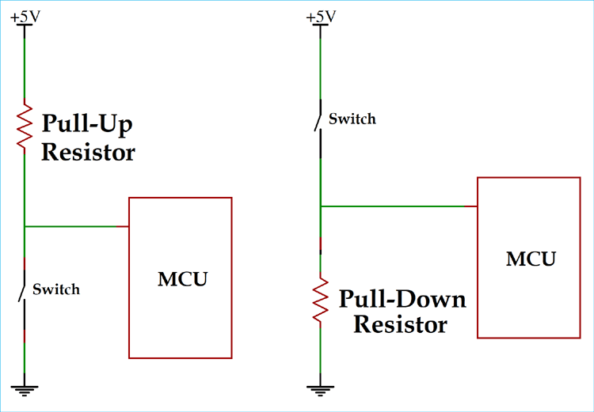

Slide 12
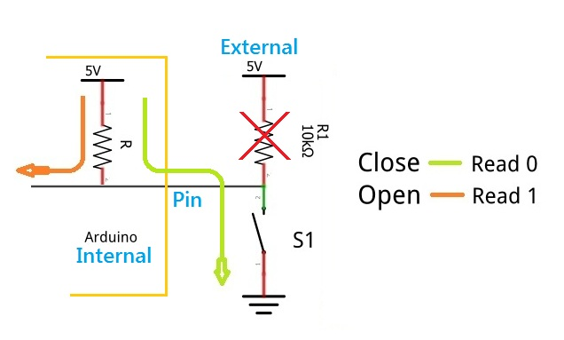

Slide 13
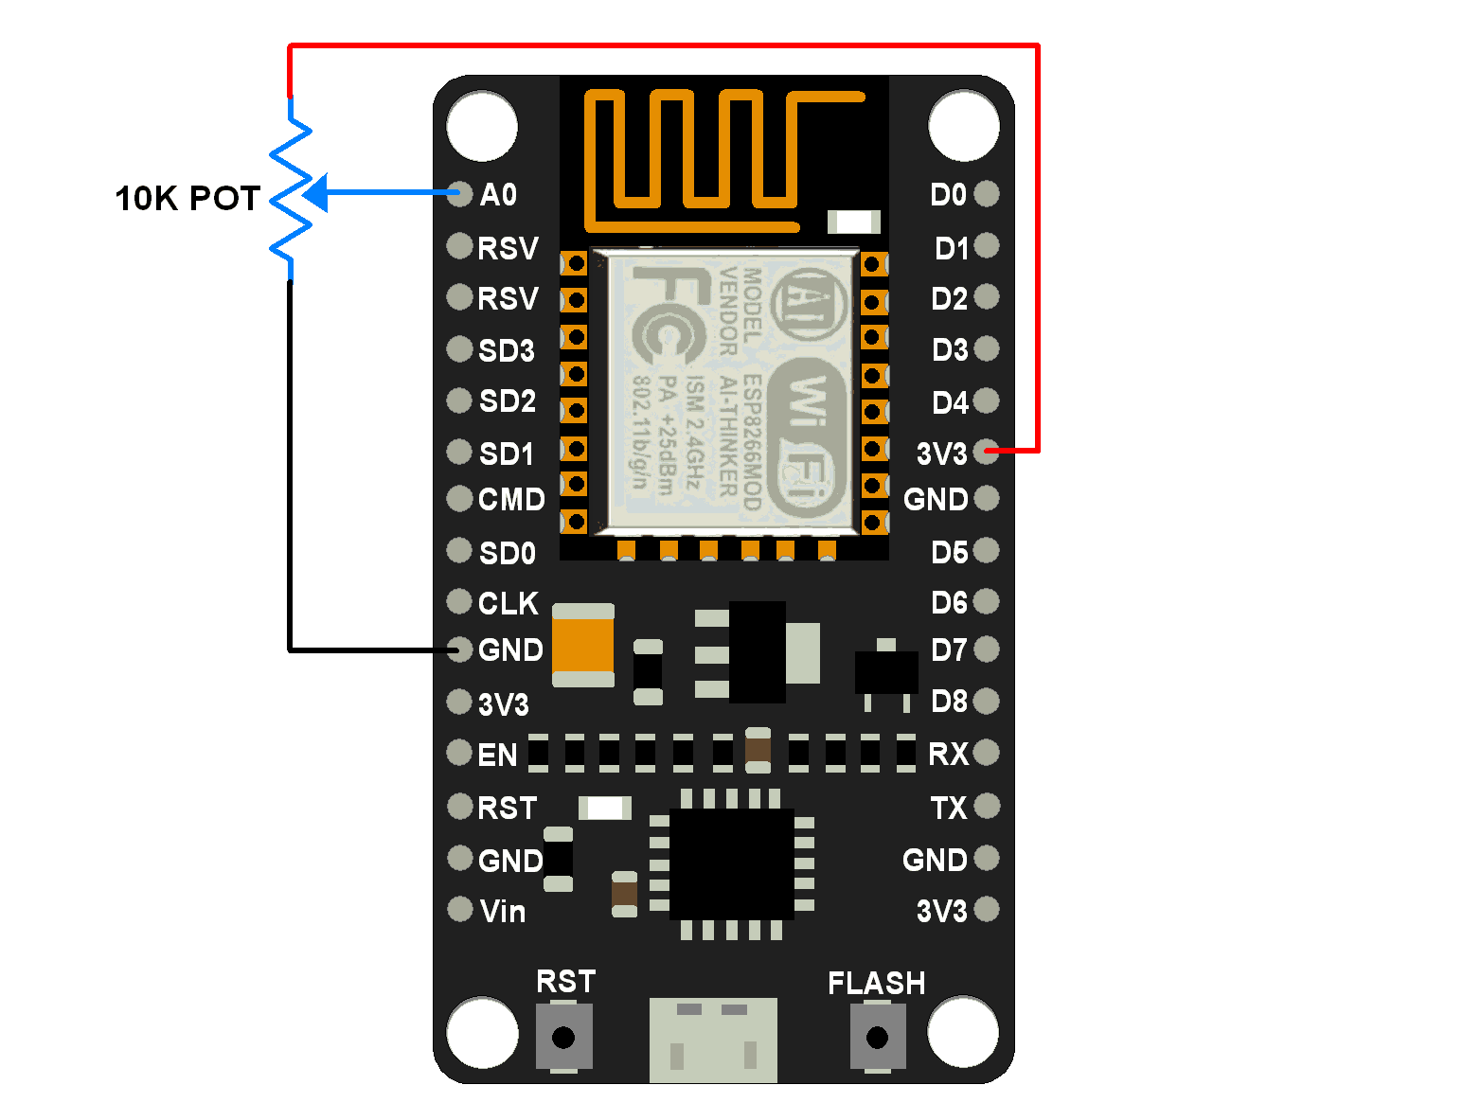

Slide 14
void setup() {
// put your setup code here, to run once:
Serial.begin(9600);
}
void loop() {
int x=analogRead(A0);
Serial.println(x);
Delay(50);
}

Slide 17
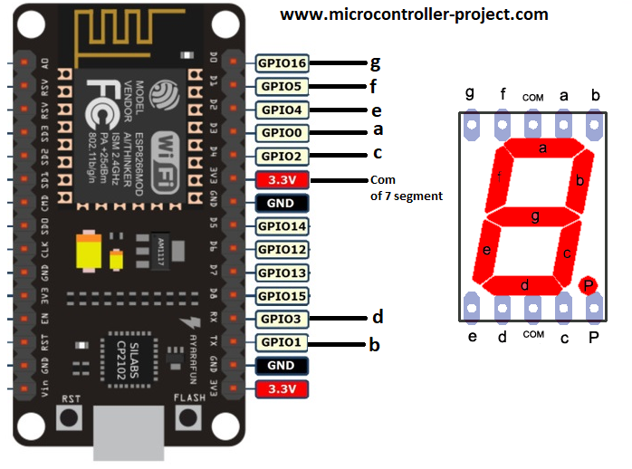

Slide 18
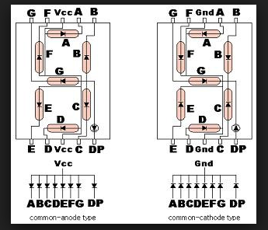
Seven Segment

Slide 19
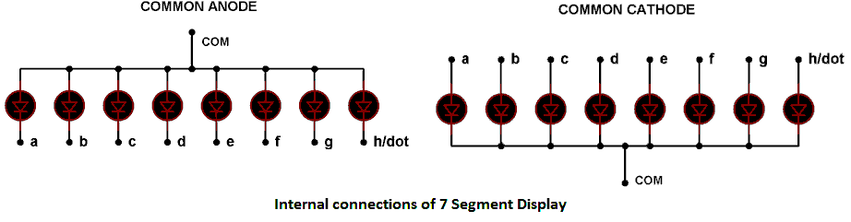

Slide 20
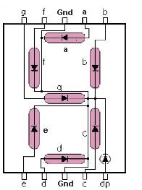

Slide 21
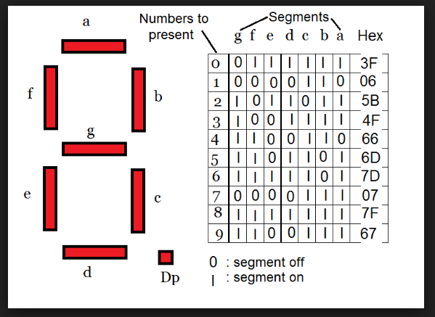
Common Cathode Seven Segment

Slide 22
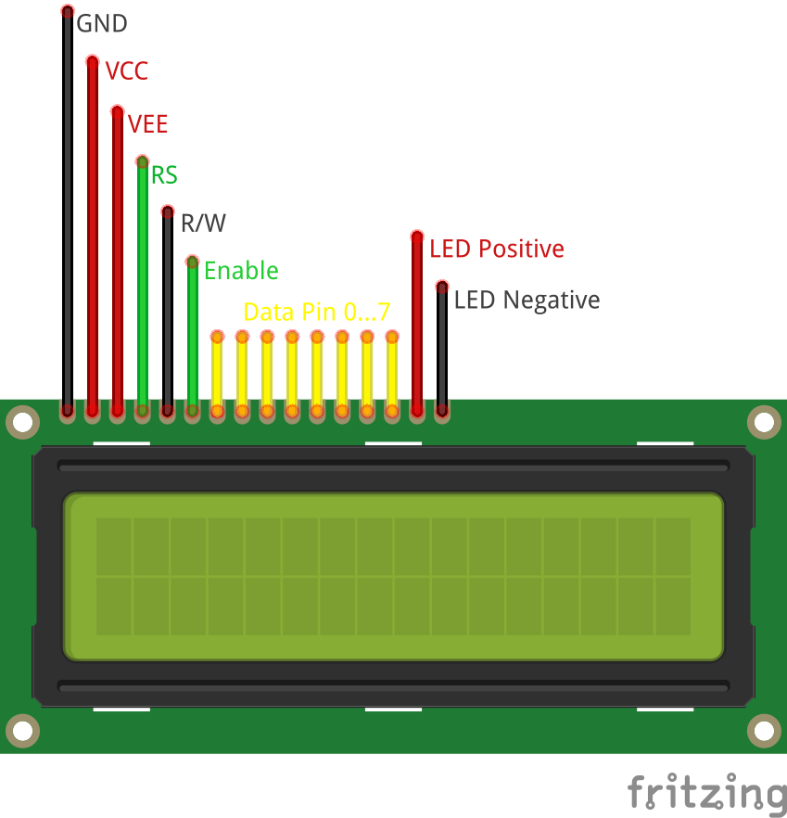

Slide 23
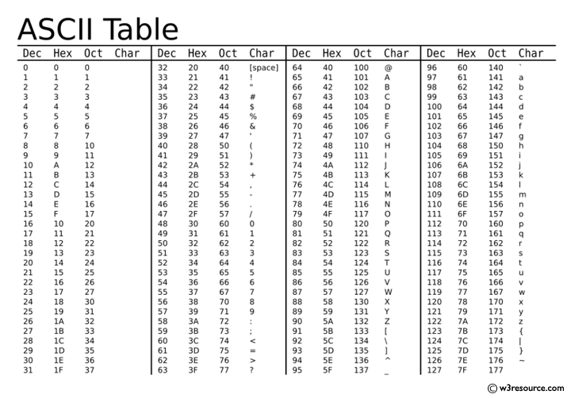

Slide 24
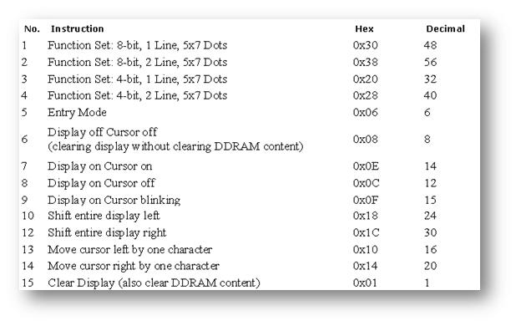

Slide 27
Library “LiquidCrystal.h” is used for easily controlling the LCD module using Arduino/Node MCU board with the help of built in methods defined inside the library For example, data string can be printed on the LCD module by merely calling a method lcd.print(),The library is readily available with the Arduino IDE (as its a pre installed standard library). The LiquidCrystal.h library provides functions/methods for almost all applications like printing a string, setting the cursor, initializing the LCD, scrolling the display, auto scroll, clear LCD, blink cursor etc.

Slide 28
#include <LiquidCrystal.h>
LiquidCrystal lcd(18, 19, 5, 4, 2,15);//lcd(rs,en,d4,d5,d6,d7)
void setup()
{
lcd.begin(16, 2);
}
void loop()
{
lcd.setCursor(0,0);
lcd.print("Welcome to the ");
lcd.setCursor(0,1);
lcd.print("class of ECE662");
}

Slide 29
LiquidCrystal()
LiquidCrystal abc(rs, enable, d4, d5, d6, d7) LiquidCrystal abc (rs, rw, enable, d4, d5, d6, d7) LiquidCrystal abc (rs, enable, d0, d1, d2, d3, d4, d5, d6, d7) LiquidCrystal abc (rs, rw, enable, d0, d1, d2, d3, d4, d5, d6, d7)
begin() lcd.begin(cols, rows)
clear() lcd.clear()
setCursor() lcd.setCursor(col, row)
print() lcd.print(data)
cursor() lcd.cursor()
noCursor() lcd.noCursor()
blink() lcd.blink()

Slide 30
blink() lcd.blink()
noBlink() lcd.noBlink()
display() lcd.display()
noDisplay() lcd.noDisplay()
scrollDisplayLeft() lcd.scrollDisplayLeft()
scrollDisplayRight() lcd.scrollDisplayRight()

Slide 31
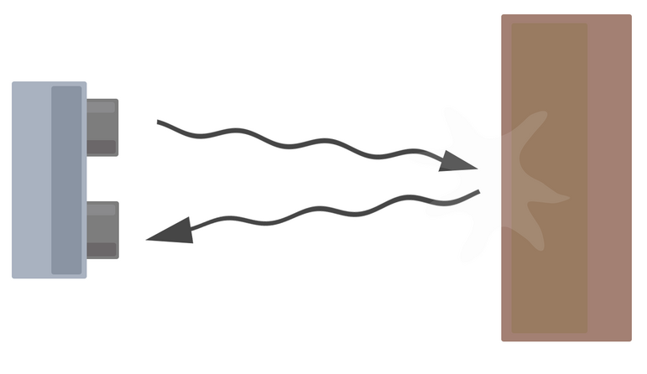
Ultrasonic Sensor
An Ultrasonic sensor is a device that can measure the distance to an object by using sound waves.
It measures distance by sending out a sound wave at a specific frequency and listening for that sound wave to bounce back.
By recording the elapsed time between the sound wave being generated and the sound wave bouncing back, it is possible to calculate the distance between the sonar sensor and the object.

Slide 32

Ultrasonic Sensor
Since it is known that sound travels through air at about 344 m/s (1129 ft/s), you can take the time for the sound wave to return and multiply it by 344 meters (or 1129 feet) to find the total round-trip distance of the sound wave.
Round-trip means that the sound wave traveled 2 times the distance to the object before it was detected by the sensor; it includes the 'trip' from the sonar sensor to the object AND the 'trip' from the object to the Ultrasonic sensor (after the sound wave bounced off the object).
To find the distance to the object, simply divide the round-trip distance in half.

Slide 33
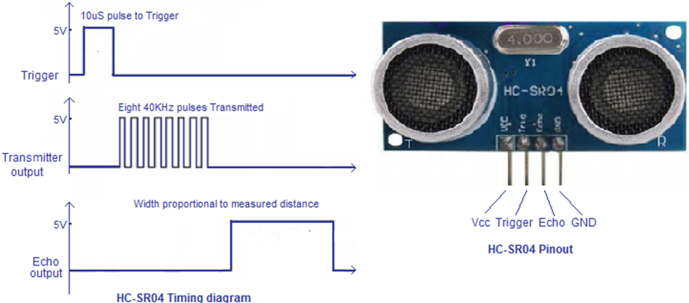

Slide 34
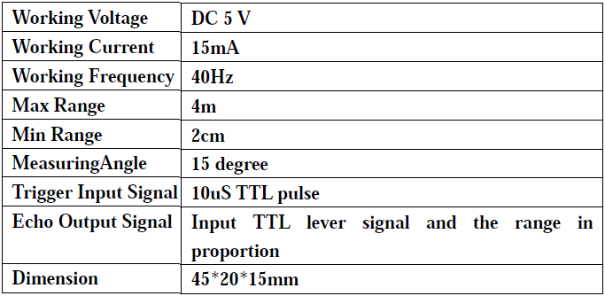
(1) Using IO trigger for at least 10us high level signal,
(2) The Module automatically sends eight 40 kHz and detect whether there is a pulse signal back.
(3) IF the signal back, through high level , time of high output IO duration is the time from sending ultrasonic to returning.

Slide 35
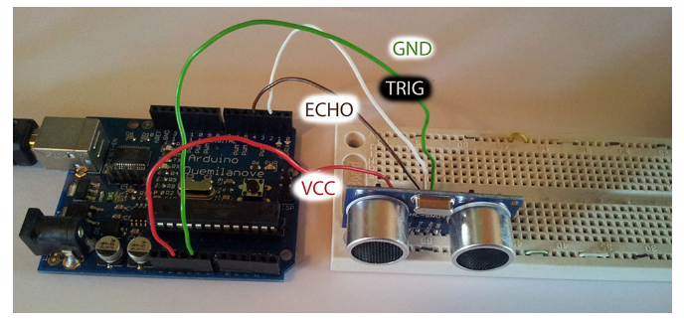
The Trig pin will be used to send the signal and the Echo pin will be used to listen for returning signal

Slide 36
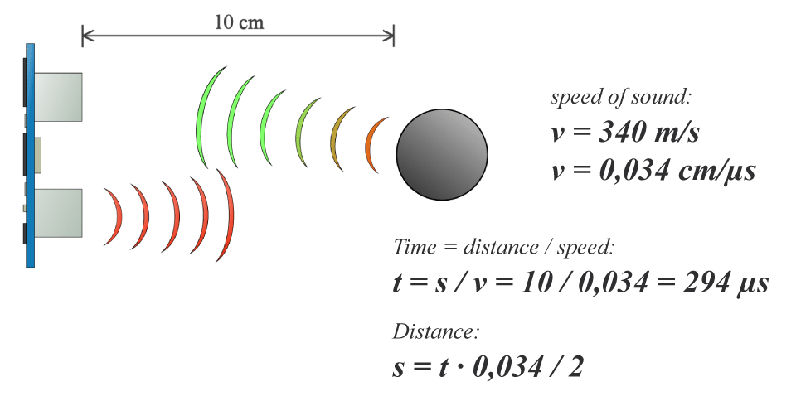

Slide 37
pulsein(pin,value): Reads a pulse (either HIGH or LOW) on a pin.
For example, if value is HIGH, pulseIn() waits for the pin to go HIGH,
starts timing, then waits for the pin to go LOW and stops timing.
Returns the length of the pulse in microseconds or 0 if no complete pulse was received within the timeout.

Slide 38
const int trigP=D2;
const int echoP=D0;
long duration;
int distance;
void setup()
{
pinMode(trigP,OUTPUT);
pinMode(echoP,INPUT);
Serial.begin(9600); }
void loop() {
digitalWrite(trigP,LOW);
delayMicroseconds(2);
digitalWrite(trigP,HIGH);
delayMicroseconds(10);
digitalWrite(trigP,LOW);
duration=pulseIn(echoP,HIGH);
distance=duration*0.034/2;
Serial.print("Distance=");
Serial.println(distance);delay(500);
}

Slide 39
#define trigPin 13 //Sensor Echo pin connected to Arduino pin 13
#define echoPin 12 //Sensor Trip pin connected to Arduino pin 12
void setup()
{
pinMode(trigPin, OUTPUT);
pinMode(echoPin, INPUT);
Serial.begin(9600);
}

Slide 40
void loop()
{
long duration, distance;
digitalWrite(trigPin, LOW);
delayMicroseconds(2);
digitalWrite(trigPin, HIGH);
delayMicroseconds(10);
digitalWrite(trigPin, LOW);
duration = pulseIn(echoPin, HIGH);
distance= duration*0.034/2;

Slide 41
Serial.print("Target Distance:");
Serial.print(distance);
Serial.println("cm");
delay(500); //pause (for 0.5 sec) to let things settle
}

Slide 42
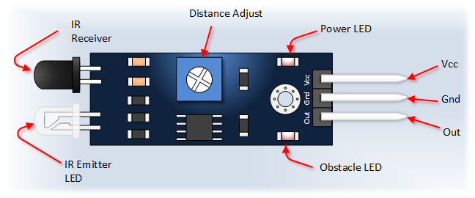
IR Sensor

Slide 43
IR Sensor
void setup() {
pinMode(13, OUTPUT);
pinMode(2, INPUT);
Serial.begin(9600);
}
void loop()
{
int x=digitalRead(2);
if (x==0)
{
digitalWrite(13,LOW);
Serial.println(“no object”);
delay(500);
else
{
}
}
}

Slide 44
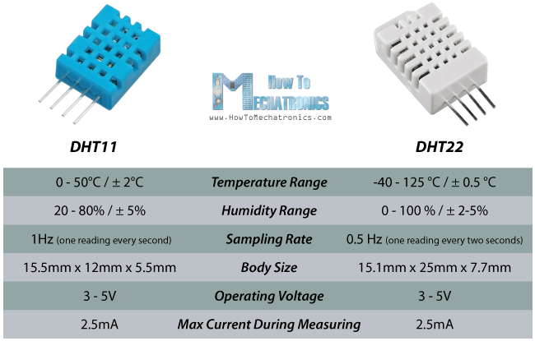

Slide 45
The output given out by the data pin will be in the order of 8bit humidity integer data
+ 8bit the Humidity decimal data
+8 bit temperature integer data
+ 8bit fractional temperature data
+8 bit parity bit

